Slide 1
Seasonal adjustment processes in statistical production
ROME, October 14, 2024
INFORMAL MEETING #1
ALESSANDRO PIOVANI | alessandro.piovani@istat.it
Istat | Directorate For Methodology and Statistical Process Design

Slide 2
Seasonal Adjustment process
Seasonal adjustment process requires:
storage of data: raw and seasonally adjusted (SA), external regressors
storage of specifications
updating of the data
binding data and specifications
processing

Slide 3
Storage
Workspace (WS):
data and specifications together
in general one workspace per domain (many time series data and spec. together)
WSs created with
GUI: link to external sources (e.g. files, db)
RJDemetra/rjd3: data embedded in workspaces (☺)
Production Data Bases
records = single time series (not domains)
model specifications history: revision checks

Slide 4

DB models for statistical production: concurrent revision – SETTING 1: Domain workspaces
Time series name | Metadata | Values | Domain
FATEXP_10 | … | <10, 9.4, 8.9,…> | FAT
C_DEFL | … | <1.2, 3, 2.6,…> | FAT
VATPIA | … | <3.1, 3, 2.8,…> | TUR
VATAIA | … | <1.6, 2.2, 2.7,…> | TUR
… | … | … | …
Domain | T | Workspace (data+spec)
FAT | 1
FAT | 2
FAT | …
FAT | N
TUR | 1
TUR | 2
TUR | …
TUR | N
3a) check_data()
1) download data and ws, update_data(), decide specs (with GUI), compare_sa_ts(*, **) to contain revisions
*
**
4) Processing
(RJDemetra/rjd3/cruncher)
2) upload
3b) check_external_regressors()

Slide 5
DB models for statistical production: concurrent revision – SETTING 2: Single series workspaces
Time series name | Metadata | Values | Domain
FATEXP_10 | … | <10, 9.4, 8.9,…> | FAT
C_DEFL | … | <1.2, 3, 2.6,…> | FAT
VATPIA | … | <3.1, 3, 2.8,…> | TUR
Time series name | T | Workspace (data+spec)
FATEXP_10 | 1
FATEXP_10 | 2
FATEXP_10 | … | …
FATEXP_10 | N
C_DEFL | 1
C_DEFL | 2
C_DEFL | … | …
C_DEFL | N
… | … | …
1) merge_workspaces() and downoload (or viceversa)
*
2) update_data()
3) check_data() and check_external_regressors()
4) Decide new specifications (with GUI)
**
5) compare_sa_ts(*, **)
6) Processing
(RJDemetra/rjd3/cruncher)
6) split_workspace() and upload
…

Slide 6
DB models for statistical production: concurrent revision – SETTING 3: Separate specs and data (single series)
Time series name | Metadata | Values | Domain
FATEXP_10 | … | <10, 9.4, 8.9,…> | FAT
C_DEFL | … | <1.2, 3, 2.6,…> | FAT
VATPIA | … | <3.1, 3, 2.8,…> | TUR
Time series name | T | Workspace (data+spec)
FATEXP_10 | 1 | {…}
FATEXP_10 | 2 | {…}
FATEXP_10 | … | {…}
FATEXP_10 | N | {…}
C_DEFL | 1 | {…}
C_DEFL | 2 | {…}
C_DEFL | … | {…}
C_DEFL | N | {…}
… | … | {…}
1) Downoload data and specifications
2) ws_new = JD_JSON_to_workspace(data_t,
specifications_t)
ws_old =
JD_JSON_to_workspace(data_t-1,
specifications_t-1)
3) Decide new specifications (with GUI having ws_new as input), being helped by compare_sa_ts(ws_new, ws_old)
4) JD_JSON_from_workspace(data_t,
specifications_t)
6) Processing
(RJDemetra/rjd3/cruncher)
5) Upload new JSON specifications
{…}, {…}, {…}, {…}

Slide 7
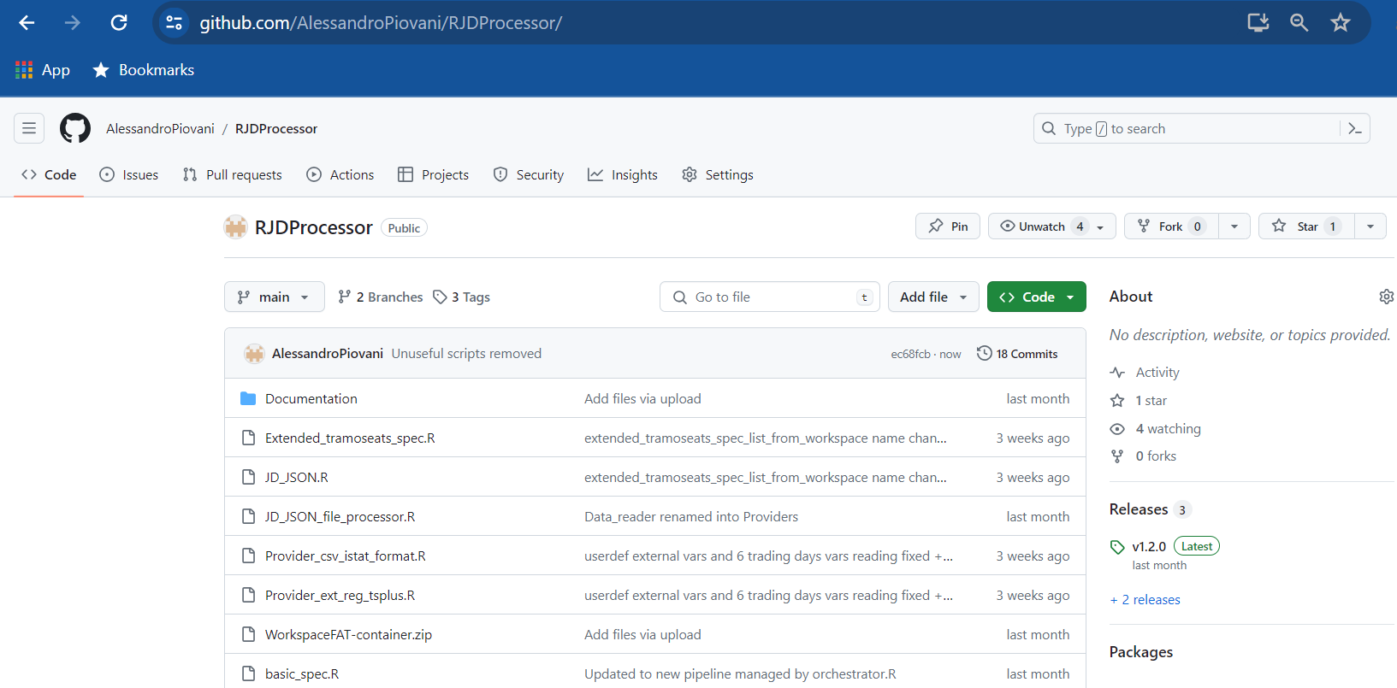
Source code
Source code is available on GitHub:
https://github.com/AlessandroPiovani/RJDProcessor
For information contact me at:
alessandro.piovani@istat.it
alessandro.piovani13@gmail.com

Slide 8
Thanks for your attention!
ALESSANDRO PIOVANI
alessandro.piovani@istat.it

